Slide 1
About the Course
The long 20th century will in all likelihood be seen in the future as the watershed in human experience:
Nine aspects:
History was economic…
Explosion of wealth…
Cornucopia of technology…
Demographic transition…
Feminist revolution…
Empowered tyrannies…
Wealth gulfs…
Inclusion and hierarchy attenuation…
Mismanagement and insecurity…
Humanity is unlikely to see as transformative—for good and ill, but mostly for good, I think—a century again…

Slide 2
U.C. Berkeley: Economics 115: Spring 2020
20th Century Economic History: Lecture 4: Empire and War
Brad DeLong
Department of Economics and Blum Center, U.C. Berkeley; and WCEG
delong@econ.berkeley.edu
last revised: 2020-02-03
for delivery: W 2020-02-05 17:00 HMMB390
<https://bcourses.berkeley.edu/courses/1487684>
<https://github.com/braddelong/public-files/blob/master/econ-115-lecture-4.pptx>

Slide 3
Empire
Chapters 6: Empire 1870-1914:
Empire in the age of an extraordinary technological gradient
Scrambles: For India, Egypt, Africa, informal influence in Latin America, and China. Herbert Hoover again!
Informal economic hegemony:
Emulating Britain looked good
Breaking Britain’s rules was costly
For privates, playing along was profitable
Freedom of investment
Japan’s Meiji Restoration

Slide 4
To Your iClickers!
According to Eichengreen, graphing international capital flows and mobility since 1850 over time produces a graph that is:
V-shaped
U-shaped
W-shaped
An upward line
None of the above

Slide 5
To Your iClickers!
According to Eichengreen, the responsibilities of a pre-World War I central bank as steward of the global gold standard and also as lender-of-last-resort in domestic financial crises were:
in complete harmony
in irresolvable tension
for the most part manageable, before World War I at least, via fancy footwork and good luck
not understood
none of the above

Slide 6
To Your iClickers!
According to Eichengreen, the experience of being on the gold standard for North Atlantic economies in the 1870-1914 period was by and large a happy one, and the experience of countries at the world economy’s periphery was:
also by and large a happy one.
a mixed one.
a source of considerable tension, instability, and political upset.
once again, manageable with fancy footwork and a little good luck.
none of the above.

Slide 7
To Your iClickers!
In Eichengreen’s view, if World War I had somehow been avoided, would the global gold standard have remained stable in the 1920s and 1930s?
There are no guarantees, but probably yes.
There are no guarantees, but probably no.
Certainly not!
Certainly yes—unless several North Atlantic economies experienced a socialist revolution
None of the above.

Slide 8
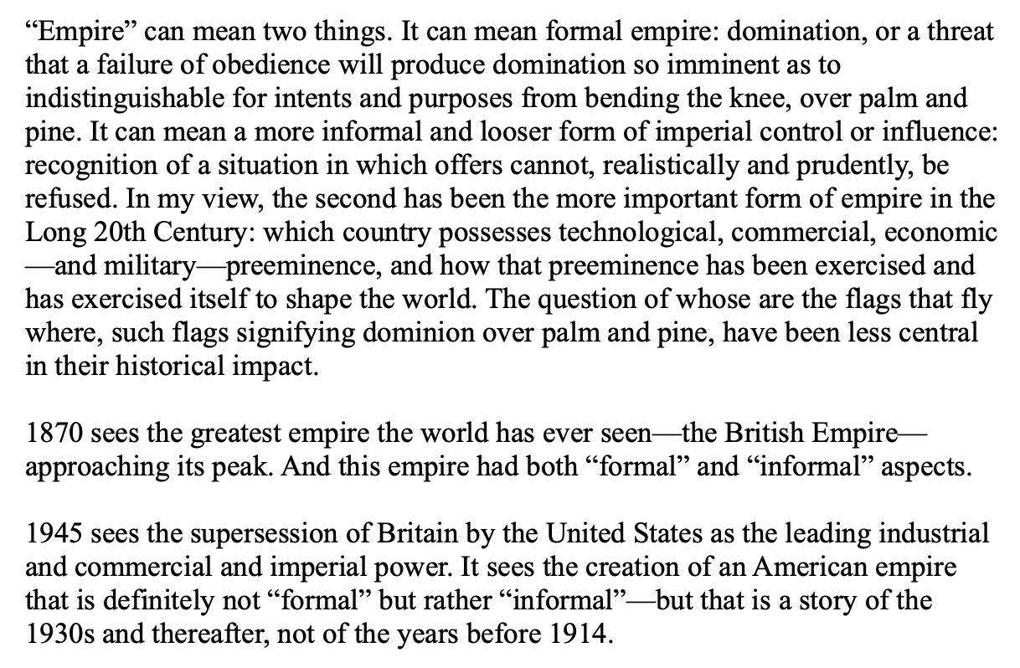
20th Century Empires
Huge but “loose”:

Slide 9
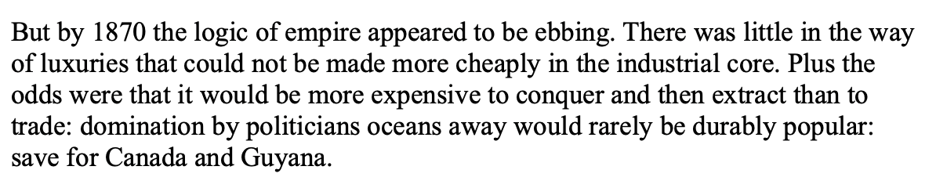
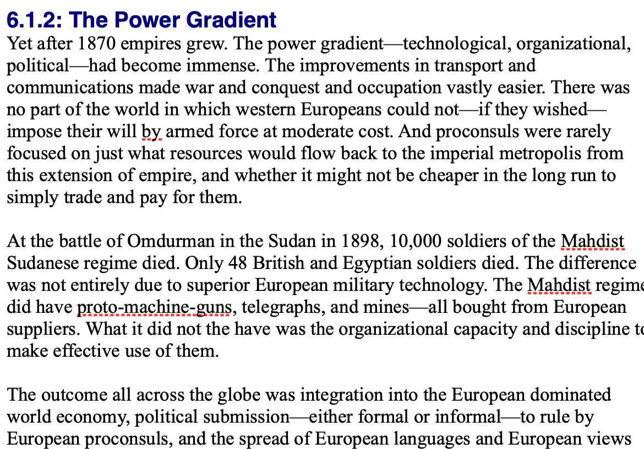
By 1810 the Tide of Empire Was Clearly Ebbing…
But things turn around: the power gradient

Slide 10
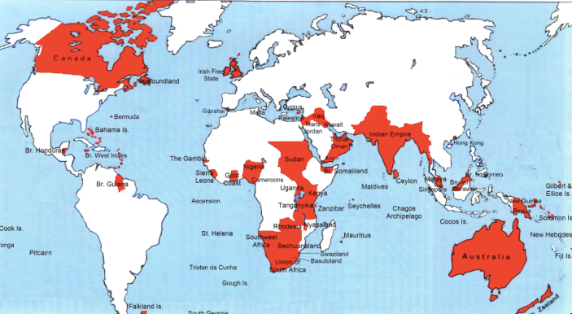
Empire

Slide 11
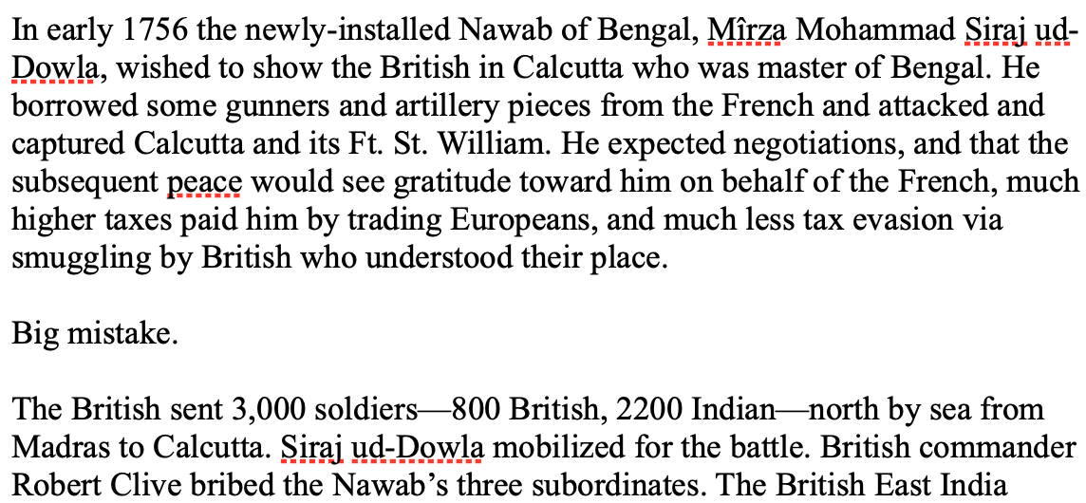
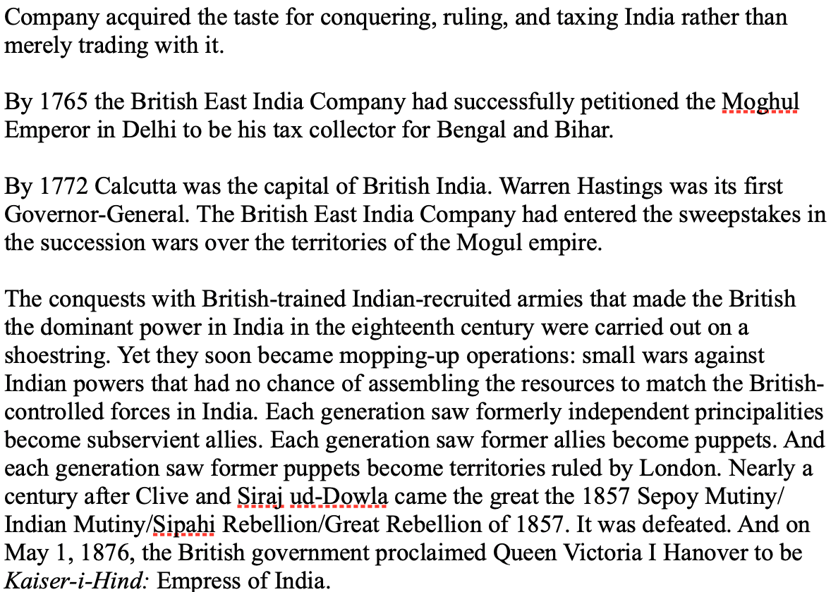
India
How do the British manage to conquer India?

Slide 12
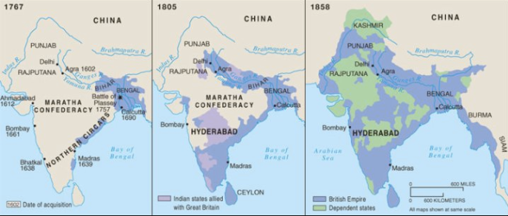
The Conquest of India
1767: Bombay, Madras, Calcutta, and tax collector for the collapsing Mogul Empire in Bengal and Oudh
1805: armies composed 3/4 of soldiers born in India; Viceroy Richard Wellesley’s conquest policy
1858: conquest complete with suppression of Sipahi Uprising

Slide 13
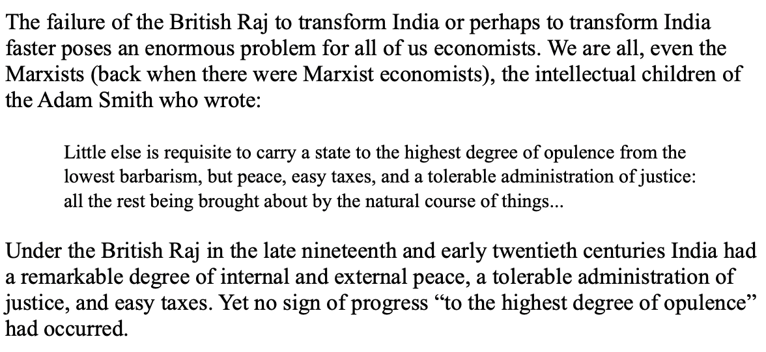
India
Why didn’t the British transform India into an industrial power?

Slide 14
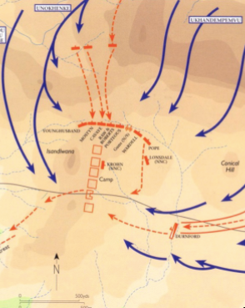
Isandlhwana
1879
Sir Henry Bartle Freer, High Commissioner for South Africa
His mandate: to “Canadaize” it…
Cape Colony
Natal
Boer Republics
Zululand
Lord Chelmsford with 15000 soldiers
The “horns and chest of the buffalo”
1300 British casualties—1300? Zulu
British reaction: “We can’t be beaten by n———“
As Cetshwayo had feared…

Slide 15
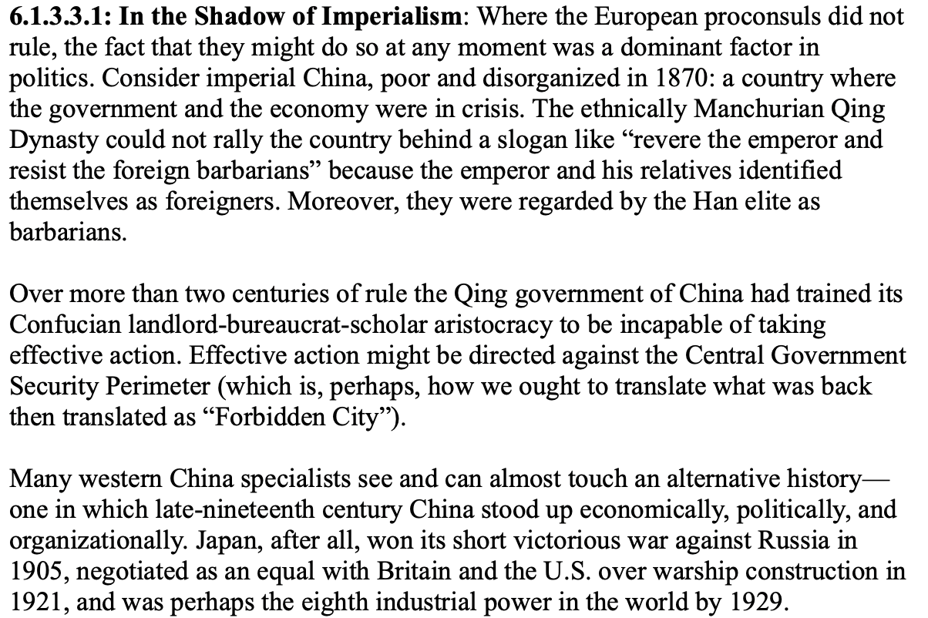
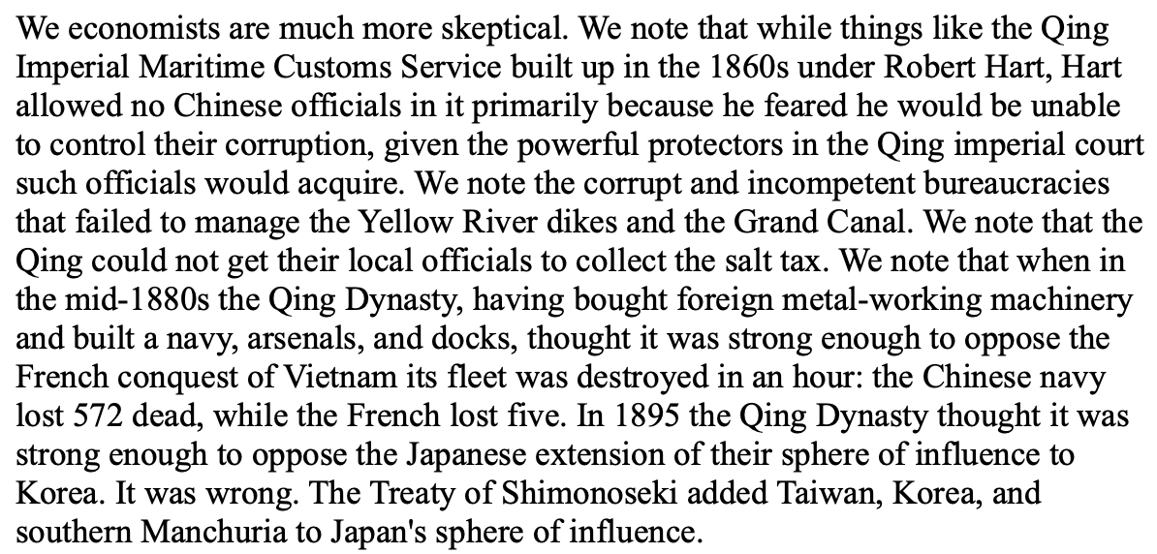
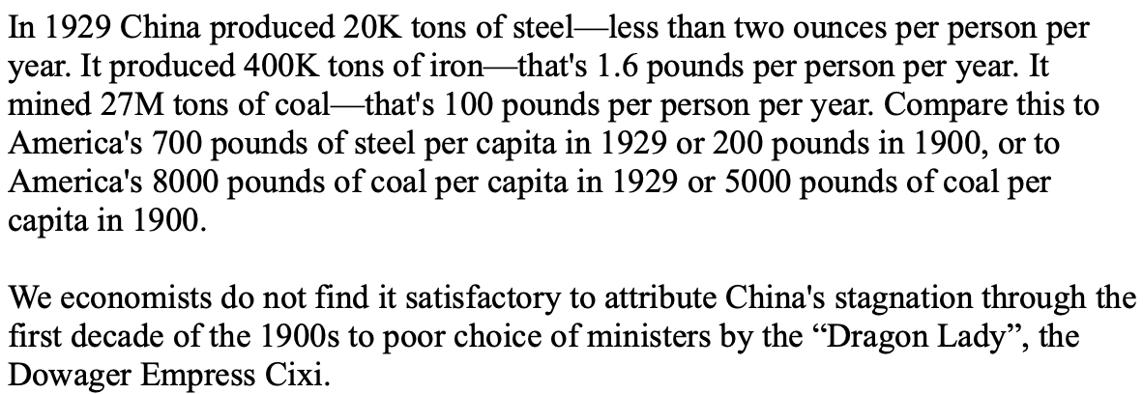
China
Why did 1870-1975 see China’s relative nadir?

Slide 16
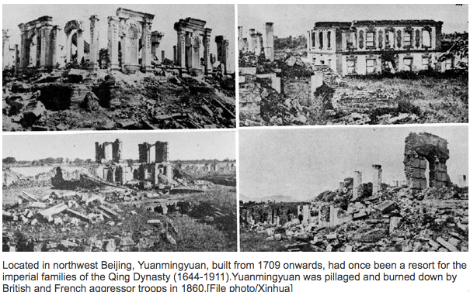
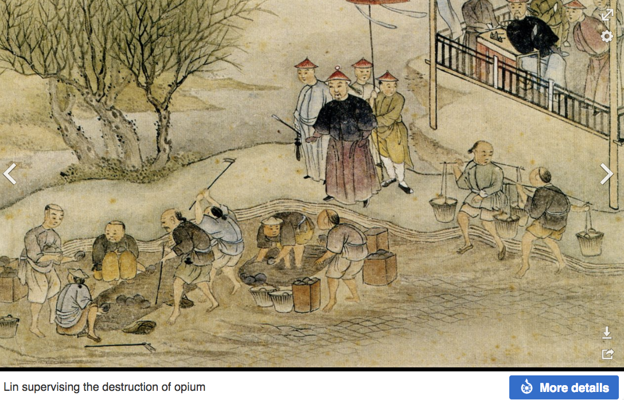
“Self-Strengthening”
The puzzle of China vs. Japan
Great Qing (大清)(1644-1912)
Wu Sangui (吳三桂)
The Rebellion of the Three Feudatories (三藩之亂)
Kangxi and Qianlong: “revere the emperor and expel the barbarians” is difficult to pursue when the emperor and his clan identify themselves as “barbarians”
Tai-Ping Rebellion (太平天國運動)
Cixi ( 慈禧太后)

Slide 17
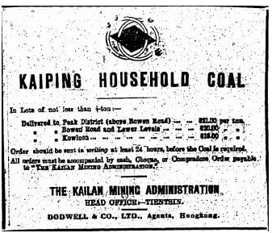
“Self-Strengthening” II
Li Hongzhang (李鴻章) and the Kai-Ping coal mine…
From 1881…
Build up an industrial base…
Opposition…
Chang Yen-Mao
Bannerman
“Boxers” (义和拳)
Herbert Hoover
Chang Yen-Mao vs. Moreing…
Li Hongzhang (李鴻章) “did not have the reputation for financial disinterest enjoyed by his patron Zeng Guofan (曾国藩)”

Slide 18
Formal Empires
There were, broadly, three views as to why European late-1800s empires rose to such domination, each of which with its own view of what was to be done to fix the situation:
One view is that of John Hobson: The major economic problem was the business cycle. Equipping the military needed to maintain the empire puts people to work. And an empire is a good source of consumers for the products of domestic factories. European governments that pursued empire, Hobson thought, were less likely to face economic distress and so more likely to continue in office.
A second view was that of Joseph Schumpeter: imperialism as the last gasp of military status aristocracy.
The third view was that empires were ordained by God—or at least morally required or desirable, for European powers had a civilizing mission. The Europeans were lucky enough to be the grownups, and it was the obligation of the grownups to civilize the world. But perhaps civilization is best spread by newspapers and books and merchants and engineers, rather than by alien proconsuls? Just a thought.

Slide 19
Informal Empires
But even where Britain (or France, or Germany, or Portugal, or Spain, or those who thought of themselves as descended from the conquistadores of Castile, or Anglo-Saxon settlers) did not rule, they reigned:
Britain seemed successful: playing by Britain’s rules seemed wise…
Britain was powerful: playing by Britain’s rules seemed likely to keep it from getting annoyed…
Britain was working very hard to make itself attractive—to make becoming a Briton-by-proxy of some sort straightforward and profitable in both money and cultural terms…
Britain was the first-mover hegemon: international cooperation was on its terms…

Slide 20
Catch Our Breath…
Comments?
Questions?

Slide 21
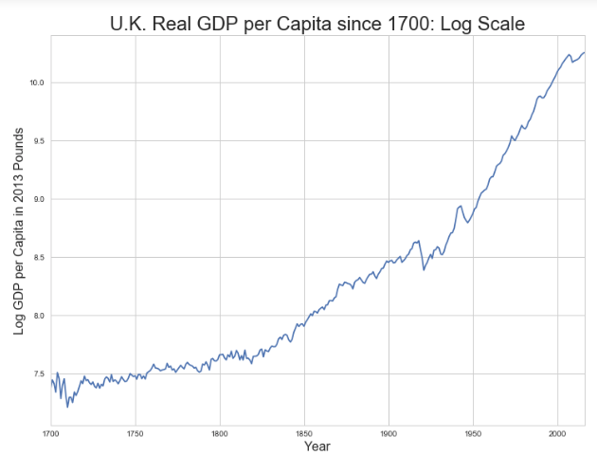
Skipped Topic: Passing the Baton: From Britain to America
The Industrial Revolution took place in Britain
The standard explanation four or five largely independent strands coming together.:
Limited government, security of property, and freedom of contract
Science and the technological tradition of sustained inquiry
Victory in the wars of the Commercial Revolution era
Machinery making, "tinkering", and "gadgets"—primarily made out of metal.
Coal in Britain—the only thing that made a steam engine potentially profitable.
Plus high elasticity of demand for leading-sector products…
http://bradford-delong.com brad.delong@gmail.com

Slide 22
iClickers: Why Breaktrhrough?
The principal reason that the Industrial Revolution took place in late eighteenth century Britain (rather than in Sung China, or Abbasid Baghdad, or Antonine Dynasty Rome, or during the Hellenistic Age) is:
A lack of human numbers thinking about problems of production
A lack of good means of communication—e.g. printing—for diffusing information about how to solve problems of production
A lack of experience using coal as an energy source
A lack of the incentive created by high real wages leading to a strong desire to make labor more productive
None of the above/not enough information
http://bradford-delong.com brad.delong@gmail.com

Slide 23
iClicker: Why Passing the Baton
The principal reason that the twentieth century was an American rather than a second British century was:
The United States’s aggressive and enthusiastic welcome of immigrants
The United States’s focus on broad-based technical education
The United States’s extraordinary abundance of natural resources driving high real wages and enormous incentives to build machines to manipulate matter
A U.S. government that took industrial development as a key policy goal, rather than being comfortable with laissez-faire
None of the above/not enough information
http://bradford-delong.com brad.delong@gmail.com

Slide 24
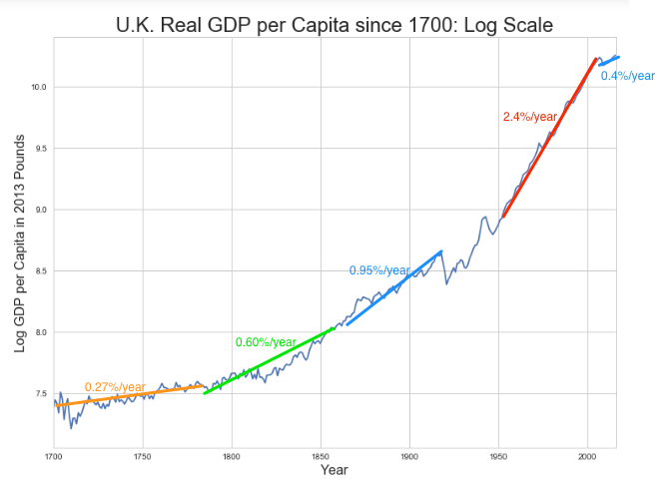
British Productivity Growth Acceleration
http://bradford-delong.com brad.delong@gmail.com

Slide 25
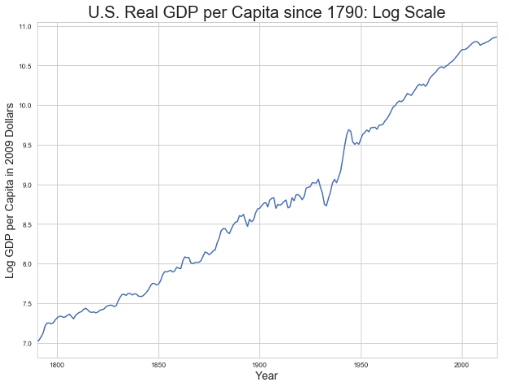
But Even in the First Half of the Nineteenth Century the U.S. Was Outpacing Britain in Growth…
Even in the first half of the nineteenth century—the period in which the British Industrial Revolution made it the wonder of the world—economic growth in the United States was proceeding faster than in Britain.
While British real GDP per capita was increasing at less than 0.6 percent per year
American was growing at a hair over one percent per year.
And a significantly larger share of GDP was going to the white working class in the United States, in the north at least:
The extraordinary abundance of land and the possibility of "lighting out for the territory", in the words of American author Mark Twain, gave even workers without property or notably scarce skills substantial economic bargaining power.
http://bradford-delong.com brad.delong@gmail.com

Slide 26
And Starting in the Late Nineteenth Century
Second Industrial Revolution…
Why the U.S. and Germany, and not Britain?
Immigration and Population
Was resource scarcity no longer a factor?
Was the differential in the growth rate h of the stock of useful economic knowledge even greater than the differential in the growth rate g of the efficiency-of-labor?
http://bradford-delong.com brad.delong@gmail.com

Slide 27
Phases of American Growth
1.0% per year in GDP per capita from 1760-1860: resource abundance
1.6% per year in GDP per capita from 1860-1929:
“Great traverse”: K/Y ratio up from 2.5 to 4
Half of it an increase in savings rates
Half of it a fall in the price of capital goods
2.5% per year in GDP per capita from 1929-1973
“Fordism”
Expected further acceleration: it did not happen
Post-1973
Productivity slowdown 1973-1995 (environment, oil, baby boom, feminism)
“New economy” 1995-2006
Post-2006 collapse of growth
http://bradford-delong.com brad.delong@gmail.com

Slide 28
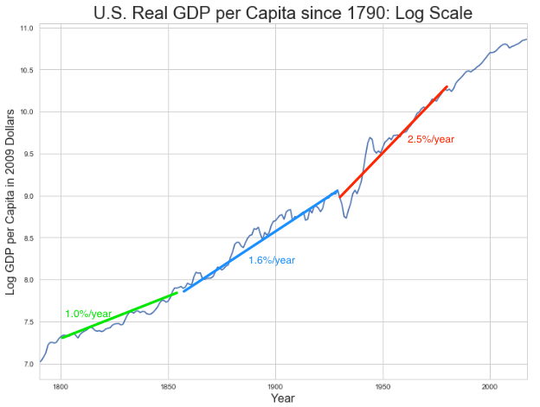
American Productivity Growth Acceleration
http://bradford-delong.com brad.delong@gmail.com

Slide 29
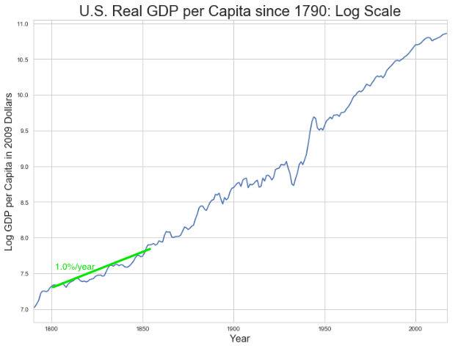
Early Nineteenth Century: Westward Expansion
Westward expansion
The “American System”
Abundant natural resources
Very high real wages
Focus on raising labor productivity
Hence fast efficiency-of-labor growth
Britain, by contrast, focused on economizing on (non-coal) raw materials
http://bradford-delong.com brad.delong@gmail.com

Slide 30
The Importance of Resources 1760-1860
Major westward expansion and "Amerindian removal”
The century 1760 to 1860 before the Civil War.
We have U.S. output-per-worker growth then at about 1.0% per year…
…in contrast to British output-per-worker growth at about 0.5% per year.
We have the U.S. population and labor force growing at 2.5% per year…
…from 2.5 to 30 million.
http://bradford-delong.com brad.delong@gmail.com

Slide 31
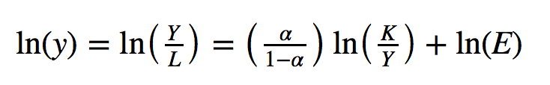
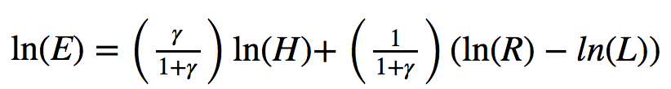
The Importance of Resources 1760-1860
Recall our basic Solow Model:
http://bradford-delong.com brad.delong@gmail.com

Slide 32
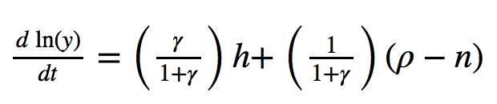
The Importance of Resources 1760-1860
Recall our basic Solow Model:
Assume K/Y constant, so the growth rate g of the efficiency of labor and the growth rate of output-per-worker are the same:
http://bradford-delong.com brad.delong@gmail.com

Slide 33
The Importance of Resources 1760-1860
Recall our basic Solow Model:
Assume K/Y constant, so the growth rate g of the efficiency of labor and the growth rate of output-per-worker are the same:
http://bradford-delong.com brad.delong@gmail.com

Slide 34
The Importance of Resources 1760-1860
Recall our basic Solow Model:
Assume K/Y constant, so the growth rate g of the efficiency of labor and the growth rate of output-per-worker are the same:
Let’s, last, fit this to history in the century before the 1860 election of President Abraham Lincoln and the ensuing American Civil War:
http://bradford-delong.com brad.delong@gmail.com

Slide 35
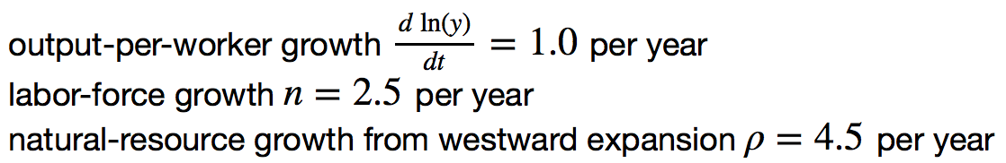
The Importance of Resources 1760-1860
Recall our basic Solow Model:
Assume K/Y constant, so the growth rate g of the efficiency of labor and the growth rate of output-per-worker are the same:
Let’s, last, fit this to history in the century before the 1860 election of President Abraham Lincoln and the ensuing American Civil War:
http://bradford-delong.com brad.delong@gmail.com

Slide 36
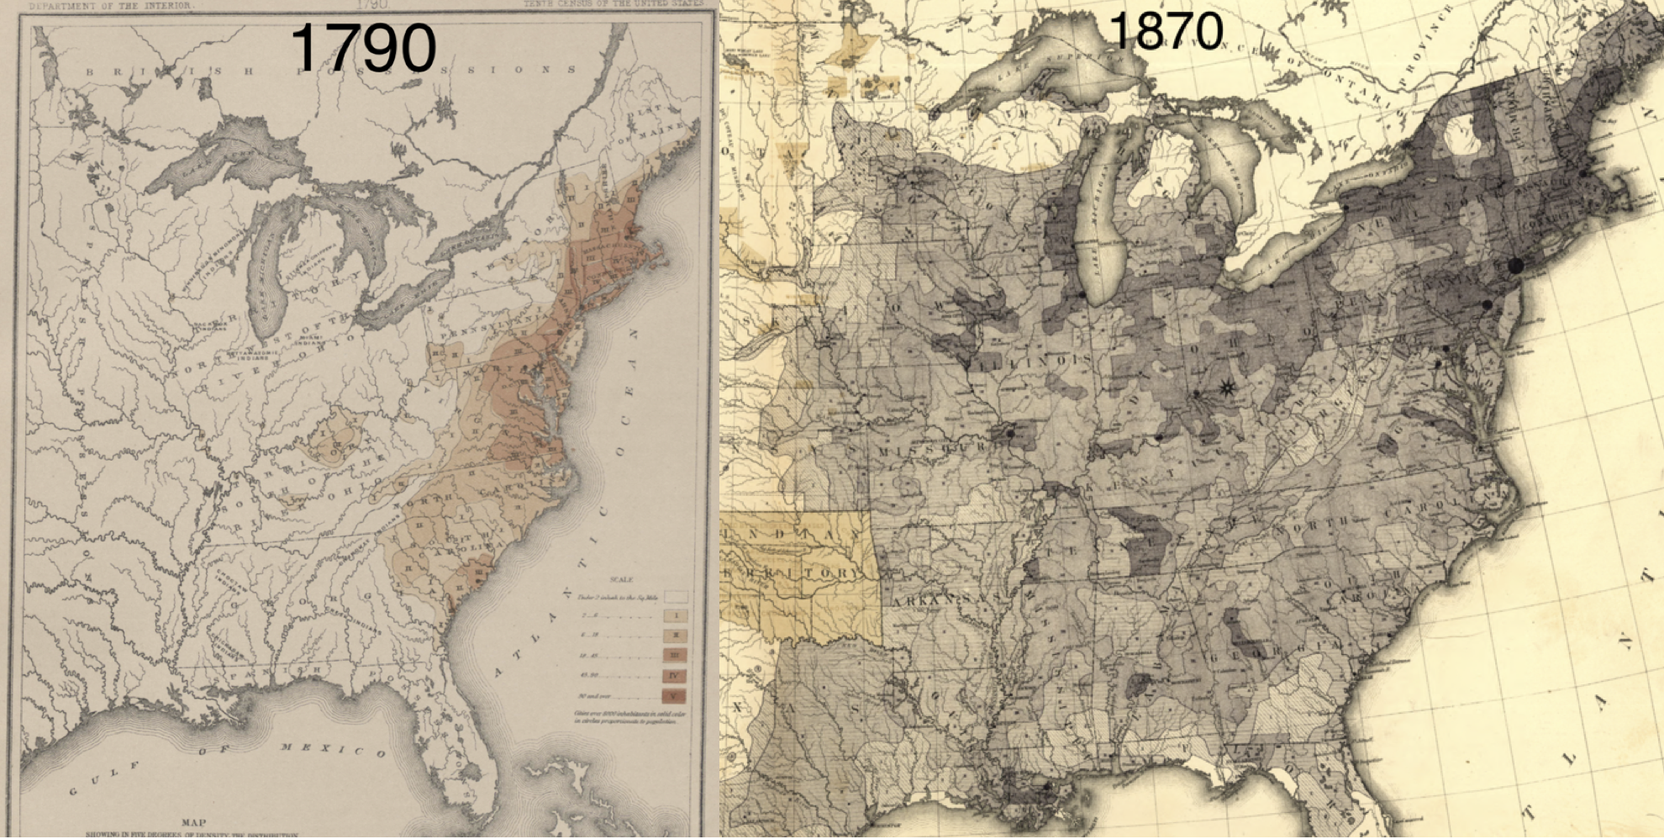
Westward Expansion
http://bradford-delong.com brad.delong@gmail.com

Slide 37
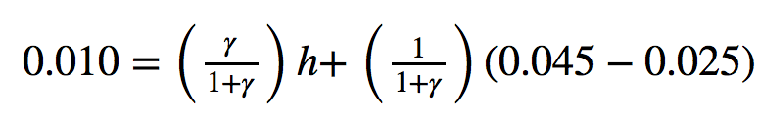
The Importance of Resources 1760-1860
We have two parameters left: γ and h, the weight of ideas in efficiency-of-labor growth and the rate of growth of the stock of useful ideas for the economy in American heads, respectively:
http://bradford-delong.com brad.delong@gmail.com

Slide 38
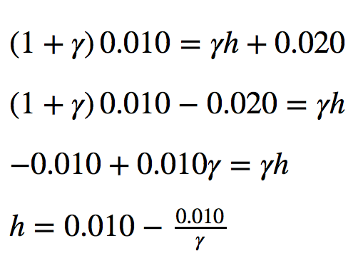
The Importance of Resources 1760-1860
We have two parameters left: γ and h, the weight of ideas in efficiency-of-labor growth and the rate of growth of the stock of useful ideas for the economy in American heads, respectively:
http://bradford-delong.com brad.delong@gmail.com

Slide 39
The Importance of Resources 1760-1860
Thus if γ→∞ then h→0.010
http://bradford-delong.com brad.delong@gmail.com

Slide 40
The Importance of Resources 1760-1860
Thus if γ→∞ then h=0.010
Thus if γ=3.0 then h=0.00667
http://bradford-delong.com brad.delong@gmail.com

Slide 41
The Importance of Resources 1760-1860
Thus if γ→∞ then h=0.010
Thus if γ=3.0 then h=0.00667
Thus if γ=1.0 then h=0.00
http://bradford-delong.com brad.delong@gmail.com

Slide 42
The Importance of Resources 1760-1860
Thus if γ→∞ then h=0.010
Thus if γ=3.0 then h=0.00667
Thus if γ=1.0 then h=0.00
Looking across the Atlantic Ocean to Great Britain, we see that over there it is indeed the case that h=0.005 from 1760 to 1860. Faster growth of h in America due to some catchup with the world's first and leading industrial nation seems likely. So γ=3.0 has some claim to be the most likely value…
http://bradford-delong.com brad.delong@gmail.com

Slide 43
A Counterfactual
The Royal Proclamation of October 1763:
Our Royal Will and Pleasure… no... Governor or Commander in Chief in... our... Colonies or Plantations in America do... grant Warrants of Survey, or pass Patents for any Lands beyond the Heads or Sources of any of the Rivers which fall into the Atlantic Ocean from the West and North West, or upon any Lands whatever, which, not having been ceded to or purchased by Us as aforesaid, are reserved to the said Indians, or any of them...
http://bradford-delong.com brad.delong@gmail.com

Slide 44
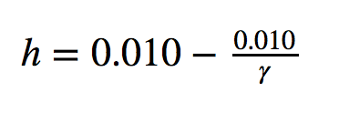
What If This Royal Proclamation Had Stuck?
What if ρ=0?
If γ → ∞ and h=0.010 then g=0.01
If γ=3.0 and h=0.00667 then g=−0.00125
If γ=1.5 and h=0.000 then g=−0.01
http://bradford-delong.com brad.delong@gmail.com

Slide 45
What If This Royal Proclamation Had Stuck?
What if ρ=0?
If γ → ∞ and h=0.010 then g=0.01
If γ=3.0 and h=0.00667 then g=−0.00125
If γ=1.5 and h=0.000 then g=−0.01
An America penned behind the Appalachians would probably have seen its living standards and productivity levels not growing at 1% per year from 1760 to 1860 but shrinking.
For γ=3.0, living standards and productivity levels would have shrunk at a pace of -0.125% per year
http://bradford-delong.com brad.delong@gmail.com

Slide 46
What If This Royal Proclamation Had Stuck?
What if ρ=0?
Of course, a poorer America would probably have seen fewer immigrants.
But it might not have seen that many fewer immigrants.
It would no longer have been quite as attractive to move from Britain to America over 1760 to 1860.
But it still would have been very attractive to move from France, Germany, Scotland—or most of all from Potato Blight-ridden Ireland...
In what other ways might this counterfactual alternate-history "little America" would likely have been different in 1860 than America actually was?
http://bradford-delong.com brad.delong@gmail.com

Slide 47
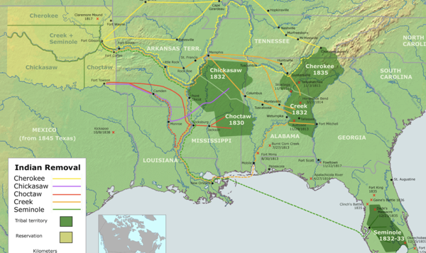
“Trail of Tears’
http://bradford-delong.com brad.delong@gmail.com

Slide 48
A large chunk of America's pre-1860 visible growing prosperity was based not just on African-American slavery, but also on "Amerindian removal"
http://bradford-delong.com brad.delong@gmail.com

Slide 49
Catch Our Breath…
Ask me two questions…
Make two comments…

Slide 50
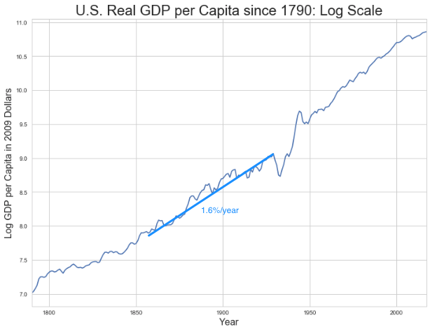
Late Nineteenth-Early Twentieth Century: “Great Traverse”
Invention of the industrial research lab
First globalization
Technologies of Second Industrial Revolution
Economies of scale and mass production
Falling price of capital goods
Greater savings effort
Plus mass immigration
Rapidly rising inequality
Or was it? Emancipation…
http://bradford-delong.com brad.delong@gmail.com

Slide 51
Capital Deepening
Lowered deprecation rate δ
From 5% to 3% per year
http://bradford-delong.com brad.delong@gmail.com

Slide 52
Capital Deepening
Lowered deprecation rate δ
From 5% to 3% per year
Increased savings rate s
Capital-output ratio goes from 2.5 to 4 across 70 years
http://bradford-delong.com brad.delong@gmail.com

Slide 53
Capital Deepening
Lowered deprecation rate δ
From 5% to 3% per year
Increased savings rate s
Capital-output ratio goes from 2.5 to 4 across 70 years
with an α=1, output-per-worker proportional to the capital-output ratio
ln(4/2.5)/70 = 0.007
g = 0.9%/year
http://bradford-delong.com brad.delong@gmail.com

Slide 54
Capital Deepening
Capital-output ratio goes from 2.5 to 4 across 70 years
with an α=1, output-per-worker proportional to the capital-output ratio
ln(4/2.5)/70 = 0.007
g = 0.9%/year
Second Industrial Revolution
Large managerial corporation
Large-scale investment banking
Industrial research lab
Continent-wide market
Globalization
http://bradford-delong.com brad.delong@gmail.com

Slide 55
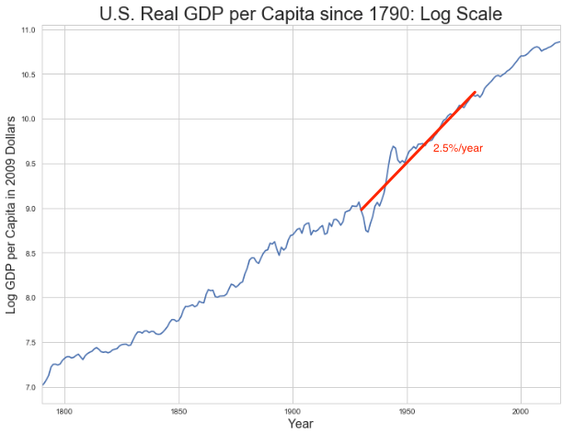
Mid Twentieth Century: Drive to High Mass Consumption
DARPA, etc.: two heads are better than one
“Fordist” oligopolies
Second globalization
Keynesian stabilization policies
Falling and then low inequality
For white guys…
http://bradford-delong.com brad.delong@gmail.com

Slide 56
Mid Twentieth Century: Drive to High Mass Consumption
DARPA, etc.: two heads are better than one
“Fordist” oligopolies
Second globalization
Keynesian stabilization policies
Falling and then low inequality
For white guys…
http://bradford-delong.com brad.delong@gmail.com

Slide 57
Catch Our Breath…
Ask me two questions…
Make two comments…

Slide 58
Econ 115: Administration: Office Hours &c.
DeLong: Office Hours
M 11:10-12:40, Blum Hall 200B
T 11:15-12:00, Blum Hall 200B
By appointment in Blum Hall 200B, Evans 691A, or elsewhere: email <delong@econ.berkeley.edu> Sign up at: <https://www.icloud.com/numbers/0leoOOlezWp6BYKSiPJhdXy7Q>
Paper due Feb 9: What Is Economics?: Assignment 3
UCLA professor Stephen Bainbridge believes that Partha Dasgupta's Economics: A Very Short Introduction is a bad book. He wrote, in his Amazon review: “1.0 out of 5 stars: Very disappointing, September 25, 2007: If you're looking for a VSI to Econ 101 and 102, skip this book. The treatment of microeconomic basics consists of exactly 14 pages. Macroeconomic theory gets a whopping 4 pages. The rest consists mainly of a political tract on wealth and poverty. It's the first VSI whose title amounts to a misrepresentation…"
Partha Dasgupta, of course disagrees. Which do you tend to agree with? (You can say that you are in the middle, but setting out and defending an "in the middle" position is actually very hard here.) Explain why and to what extent you come down on Dasgupta's or on Bainbridge's side of this dispute. Justify your opinions by setting out what you think economics is, or ought to be.
Write 400-500 words, and submit them on this webpage: <https://bcourses.berkeley.edu/courses/1487684/assignments/8051996>
By now you should have read not just Dasgupta but Eichengreen chapters 1 & 2
Memo: bCourses website <https://bcourses.berkeley.edu/courses/1487684>

Slide 59
Paper
Due Feb 9: What Is Economics?: Assignment 3
UCLA professor Stephen Bainbridge believes that Partha Dasgupta's Economics: A Very Short Introduction is a bad book. He wrote, in his Amazon review: “1.0 out of 5 stars: Very disappointing, September 25, 2007: If you're looking for a VSI to Econ 101 and 102, skip this book. The treatment of microeconomic basics consists of exactly 14 pages. Macroeconomic theory gets a whopping 4 pages. The rest consists mainly of a political tract on wealth and poverty. It's the first VSI whose title amounts to a misrepresentation…"
Partha Dasgupta, of course disagrees. Which do you tend to agree with? (You can say that you are in the middle, but setting out and defending an "in the middle" position is actually very hard here.) Explain why and to what extent you come down on Dasgupta's or on Bainbridge's side of this dispute. Justify your opinions by setting out what you think economics is, or ought to be.
Write 400-500 words, and submit them on this webpage: <https://bcourses.berkeley.edu/courses/1487684/assignments/8051996>

Slide 60
DeLong Office Hours
M 11:10-12:40, Blum Hall 200B
T 11:15-12:00, Blum Hall 200B
By appointment in Blum Hall 200B, Evans 691A, or elsewhere:
email <delong@econ.berkeley.edu>
Sign up at: <https://www.icloud.com/numbers/0leoOOlezWp6BYKSiPJhdXy7Q>

Slide 61
Memo
By now you should have read not just Dasgupta but Eichengreen chapters 1 & 2
bCourses website <https://bcourses.berkeley.edu/courses/1487684>

Slide 62
War: World War I
Chapter 7: War 1914-19
Empire and war
The knot of war
Economic illogic
Nationalism
Rehearsal: The Boer War
WWI proper
That DFT in the Balkans;
Germany attacks Belgium; w
Why not a short war?;
The Prussian way of war;
German technology and industry;
Attrition and exhaustion;
10 million dead, 10 million maimed, 1 full year of world income thrown down the sewer…

Slide 63
South Africa

Slide 64
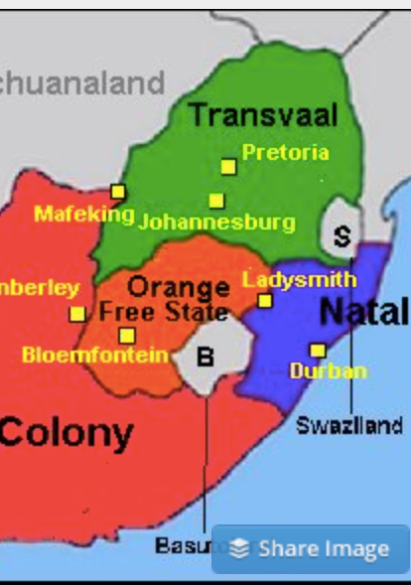
The South African Gold Rush
Remember the Zulu War?
Afterwards, the mandate to “Canadaize” South Africa put on hold…
But then the Witwatersrand…
Back up
The Great Trek
1886 Transvaal gold strike
100,000 (English speaking miners etc. in Johannesburg)
200,000 Boers
By 1913: 1M Dutch, English; 500K Indians, others; 2.5M Zulu, Tswana…

Slide 65
Convince the Boers…
The 1895 Jameson Raid
Joseph Chamberlain in 1899: equal rights for British citizens, or war
Boers struck in October 1899
40K British soldiers in South Africa
50K male Boers of potential military age
Mafeking, Ladysmith, Kimberley, Spion Kop, Vaal Kranz, Magersfontein, Stormberg, Tugela River…
Did the British negotiate?
Sent 250K soldiers
Competent commander, Lord Roberts
Boers turned to guerrilla war
British invented the concentration camp
Boer population of 200K—30K dead after the war: 10K soldiers, 15K children, 5K women and elderly.
British deaths: 8K in battle, 14K of disease
African deaths: 30K?
1900 “Khaki election”

Slide 66
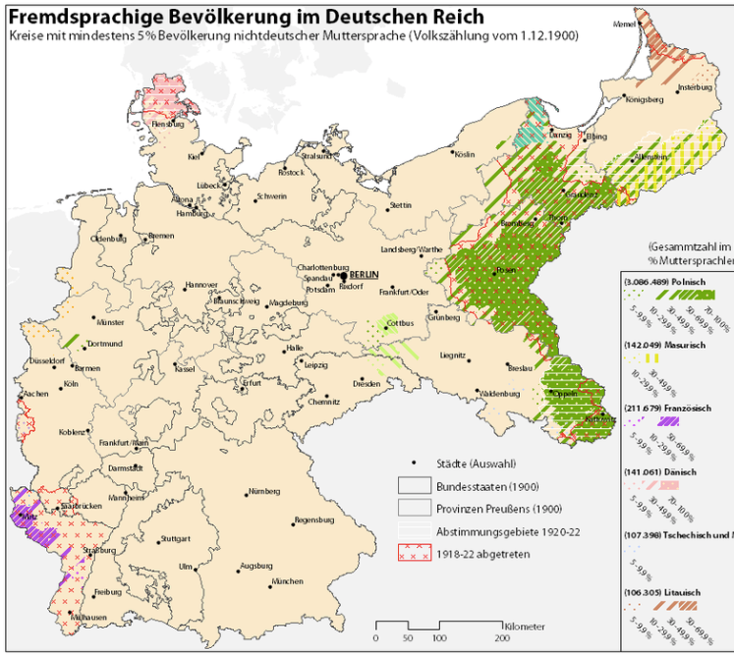
Nationalism
German sociologist Max Weber:
“The German character of the East... should be protected…. The economic policy of the state should enter into the lists in its defense.... The economic struggle between the nationalities follows its course even under the semblance of ‘peace’….
“The vulgar conception of political economy is that it consists in working out recipes for making the world happy.… However… elbow-room… can [only] be won… through the hard struggle....
“That standard of value adopted by a German economic theorist, can… be nothing other than a German policy and a German standard....
"Our successors will... hold us responsible... for the amount of elbow-room we conquer.... The science of political economy is... a servant of... the lasting political-power interests of... our nation's power, and the vehicle of that power, the German national state…”

Slide 67
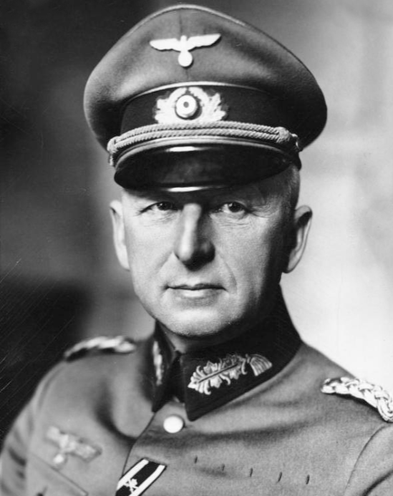
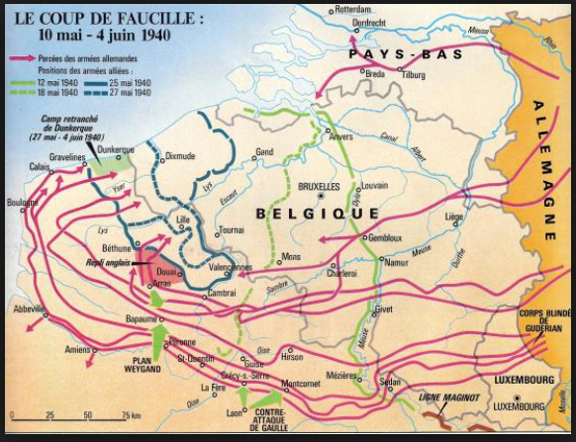
Erich von Manstein
von Manstein
von Lewinsky
Lewinski
Levi

Slide 68
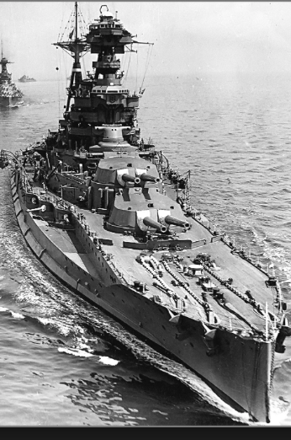
“We Offered 4, the Navy Demanded 6…
…and we compromised on 8…”
French politics welcomes a rematch…
Germany wants its place in the sun…
the German battlefleet to command “respect”
Russia seeks a short victorious war
Austria-Hungary wants to repel Balkan nationalism
Busying giddy minds with foreign quarrels?

Slide 69
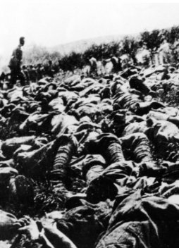
The Catastrophe of World War I: Origins
In the summer of 1914 the empires of Russia and Austria-Hungary are skirmishing diplomatically and threatening each other militarily about the latest Balkan crisis
Began when in the summer of 1914 the Archduke Franz Ferdinand and his wife Sophie were assassinated in Sarajevo
By terrorists with very close links to the intelligence service of the Kingdom of Serbia
What would Austria’s response be?
And then Germany attacks Belgium
And then Australia attacks Turkey

Slide 70
The Catastrophe of World War I: Causes
Why?: “If there is a war, let it come now…”
Russia thought it would have to fight Germany someday, and might as well while France was interested…
Austria, France, Britain (as a result of the German battle fleet) the same
“Busy giddy minds with foreign quarrels…”
A wiser man: Otto von Bismarck:
“There is nothing in the Balkans worth the bones of a single Pomeranian grenadier…”

Slide 71
The Catastrophe of World War I: Conduct
The machine gun and the artillery piece—and barbed wire
The trench line
Attrition warfare
Tank and the monoplane…
The worst generals ever
Alternatives?
Outflank (Constantinople, Salonika)
Blockade
The mystery of the German battle fleet

Slide 72
How Did the Germans Lose?
Outproduced 3-1
Short of raw materials
And, ultimately, of food
Tactical and operational success
Prussia
Fehrbellin
Friedrich II “the Great”
Metternich the moronic
Strategic, logistical, and grand-strategic catastrophe

Slide 73
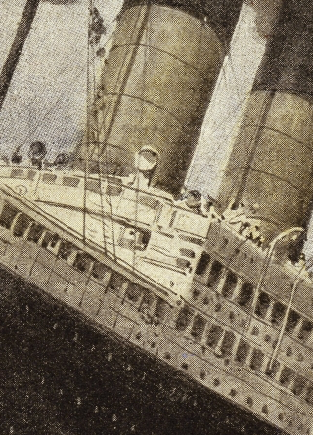
How Does the U.S. Get Involved?
British policy: binding the U.S. upper class to Britain since the 1840s
The Law of the Sea
Neutrals
Blockade
The submarine
Unrestricted submarine warfare
Zimmerman Telegram
Woodrow Wilson
“Teach the Mexicans to elect good men…”
“The war to end war…”

Slide 74
The Catastrophe of World War I: Outcome—Political
Russian, Austro-Hungarian, German, Ottoman Turkish Empires all gone…
Representative governments destabilized—or weak…
The Russian Revolution…
Hungarian, Bavarian socialist republics (short-lived)
Spartakist…
Allies demand 2 years of German GDP as “reparations”…

Slide 75
The Catastrophe of World War I: Outcome—Human
Combatants had mobilized 65M out of 100M men of military age
10M killed
10M maimed
Civilian casualties less than 10% of military
Costs of 1.5x a year’s GDP
Plus a 15M global flu epidemic

Slide 76
Catch Our Breath…
Comments?
Questions?

Slide 77
Takeaways
Chapters 6 & 7: Empire and War 1870-1914:
Empire in the age of an extraordinary technological gradient
Scrambles: For India, Egypt, Africa, informal influence in Latin America, and China. Herbert Hoover again!
Informal economic hegemony:
Emulating Britain looked good
Breaking Britain’s rules was costly
For privates, playing along was profitable
Freedom of investment
Japan’s Meiji Restoration
War
The knot of war
Economic illogic
Nationalism
Rehearsal: The Boer War
That DFT in the Balkans; Germany attacks Belgium; why not a short war?; the Prussian way of war; German technology and industry; attrition and exhaustion;
10 million dead, 10 million maimed, 1 full year of world income thrown down the sewer…

Slide 78
Preview: Next Time
On to Chapter 8: After World War I: Restoring? Civilization?:
Exhaustion: The Belle Époque Broken
The End of Aristocracy
The Birth of “Really Existing Socialism”
Social Democracy
Government Finances, Inflation, and “Reparations”
Keynes’s Protest
Post-WWI Economic Disorder
“The Deliberate Intensification of Unemployment”

Slide 79
What Was Unconvincing Today?
Mistakes and unclarities: typos, wordos, and mindos…
In the DRAFT textbook?
In the lecture?

Slide 80
Catch Our Breath…
Ask a couple of questions?
Make a couple of comments?
Any more readings to recommend?

Slide 81
Notes
Lecture- World War I #TCEH (21).key
Lecture- Arms Races and Brinkmanship #TCEH 2017-02-13 (20)
Lecture- Empire #TCEH 2017-02-08 (19).key
Lecture- The First Global Economy #TCEH 2017-02-08 (18).key
Lecture- Passing the Baton- From Britain to America #MRE #Macro #TCEH 2018-10-04.key

